Slide 1
Data Transformer
PrintNet T

Slide 2
Context Schema
Workflow
Data Input
&
Manipulation
Document
Design
(Layout)‏
Impositioning
Approval (Proof)‏
Spool Production
Notes:
Data Transformer is one of the Data Processing modules. Data from the Data Input modules can be manipulated in a Data Transformer before it gets to Layout.

Slide 3
Agenda
Introduction
Converters
    CustCode
    String Manipulation
      Basic Concatenation
      Advanced Concatenation
      Trim Options
      Replace Space with Hard Space
      Simple Case Conversion
      Mask Merge
    Stack FCVs
    ParseDateTime
    Convert Page Selection
    Case Converter
    Numerical Formatting

Slide 4

1. Introduction

Slide 5

Data Transformer – Introduction
Converts the input data from one class to another
(e.g., String to Numeric)‏
General Options
  Delete Field
  Type Conversions
  String Manipulation
  Conditional Processing
  Formatting
  Table Look Up
  PDF Page Count
  Duplicate Fields
  Create New “Work” fields

Slide 6

Data Transformer – Purpose
  Data enters workflow (via Data Input) as “String”.
  “String” data is not very flexible.
  To perform basic and advanced functions with data, “String” type variables must be converted to different data types
  Data Transformers perform data conversions so that basic and
  advanced functions are possible.
  Standard Data Types:
  String (text fields)‏
  Double (decimal numbers)‏
  Int (signed integer values)‏
  Int64 (signed integer values)‏
  Currency (decimal numbers – up to four decimal places)‏
  Bool (true/false)‏
  Date/Time (date and time format)‏
Notes:
“String” type data is essentially just text. Even if your “String” is numerical, it is only recognized as text. To perform calculations with numbers, format a different time and date style, perform true/false calculations, and much more, it is necessary to convert certain “String” variables to different types.
Int – Signed Integer values
Range from -2147483648 to 2147483647
Int64 – Signed Integer values
Range from -2^63 to 2^63 -1
Double – Decimal number
Range 5.0 x 10-324 .. 1.7 x 10308
Significant digits: 15-16

Slide 7
Data Transformer – Additional Parameters
Some conversions require additional parameters.
Examples:
  String to Double has options to ignore characters and the format of any decimal point.
  String to Date/Time – date/time format can be set.

Slide 8

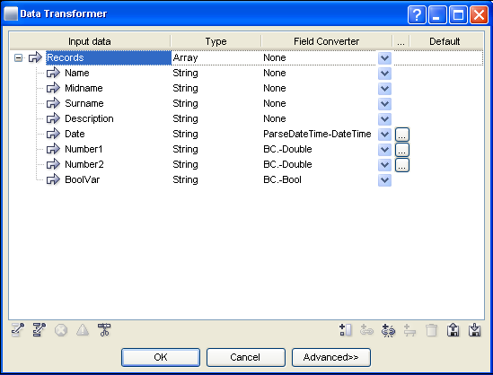
Data Transformer – Example
Notes:
The first four data inputs (excluding Records) have not been transformed, they will remain String. Date has been transformed from String to ParseDateTime; Number1 and Number2 have been transformed from String to BC.-Double; BoolVar has been transformed from String to BC.-Bool.
Note: all data fields in CSV data input files will have the type String assigned to them from the beginning. Therefore, a Data Transformer is usually necessary if you want to make calculations in your job.
Arrays cannot be transformed, only deleted.

Slide 9
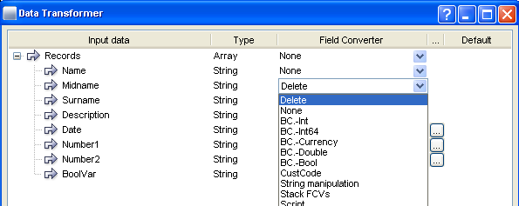
Data Transformer – Delete a Field
Choose Delete from the Field Conversion combo-box.
The field will no longer be visible in any of the workflow after
the module.
The field is not deleted from the original data file.
Notes:
A deleted field is not actually deleted, only eliminated from the workflow.
Deleting fields is a good way of simplifying your workflow if there are certain fields that you know you will not need to use.
A deleted field can always be brought back into the workflow by opening the Data Transformer and deselecting “delete” from the Field Converter.

Slide 10

2. Converters

Slide 11
CustCode Converter
Works the same as PrintNet 3 CustCode
  Can Import PrintNet 3 CustCodes
Basic look-up table
  one input match is converted to one output match
Use the default section if there is not a match to the look-up values in
the table

Slide 12
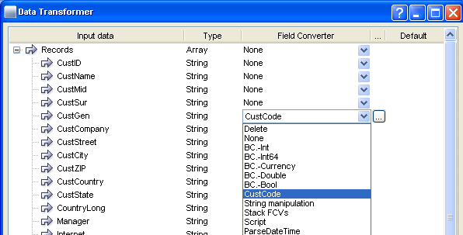
CustCode – Selecting Converter
Select CustCode converter from combo-box in Data Transformer.
Notes:
Click the “…” button to open and edit CustCode properties.

Slide 13
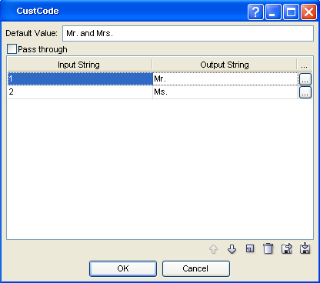
CustCode Converter
Input and Output conversion
Create new value
Notes:
CustCode conversion works with data files that specify the gender of clients. In this example, all men have the customer gender code “1” in the data file; our Data Transformer will replace every “1” with “Mr.” in the CustGen field using the CustCode converter. Every “2” will be replaced by “Ms.”, according to the CustCode converter.

Slide 14
String Manipulation
Basic String manipulations
  Concatenation Simple and Advanced
  Trim and reduce white space
  Replace spaces by hard space
  Simple case conversion
  Mask Merge

Slide 15
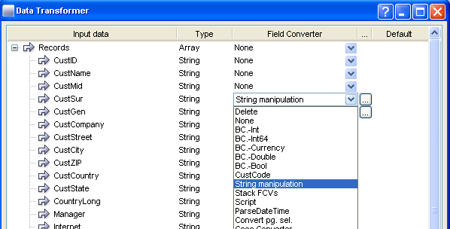
String Manipulation – Selecting Converter
Select String manipulation converter from combo-box in Data Transformer.
Notes:
Click the “…” button to open and edit String manipulation properties.

Slide 16
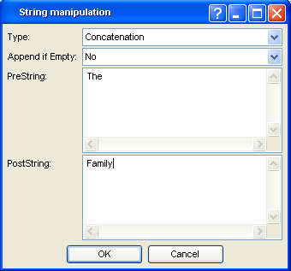
String Manipulation
Concatenation
  Adds fixed text to beginning and/or end of variable data
  Append If Empty – Should the
  fixed text be added if the
  variable is empty?
      Yes or No
Notes:
In this example, the Concatenation is being applied to the variable surnames; thus, every time the field CustSur occurs in a job, it will always have “The” before it and “Family” after it (e.g., “The Smith Family”, “The Novak Family”, “The Gilmour Family”, etc.).
Append if Empty – if there is an empty field, the Concatenation will not be applied (in this example). You can change to “Yes” if you need it.

Slide 17
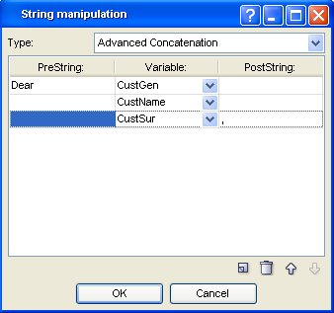
String Manipulation
Advanced Concatenation
  Appends several fields from the input stream together
  Separates fields with text before and after the variables (PreString and PostString).
Notes:
In this example, we’ve appended CustGen, CustName, and CustSur, and have added some PreString and PostString text. When viewed, this example will produce the following results: “Dear Mr. Dave Thompson,” or “Dear Ms. Alice Miller,” etc.
Remember: we’ve converted CustGen with CustCode, so “Mr.” or “Ms.” will appear instead of “1” or “2”.

Slide 18
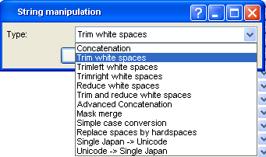
String Manipulation
Trim options – remove spaces
Notes:
When applying some String manipulations with variables, sometimes extra spaces appear, which separate texts from each other. Use trim options to fix this:
Trim White Spaces – removes spaces on the left and right of the variable.
Trimleft White Spaces – removes only leading (left) spaces from the variable.
Trimright White Spaces – removes only trailing (right) spaces from the variable.
Reduce White Spaces – finds multiple space characters within the variable field. Deletes the extra blanks leaving only one.
Trim and Reduce White Spaces – combines the Trim and Reduce options.

Slide 19
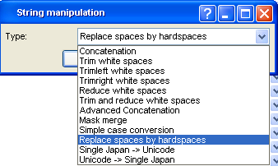
String Manipulation
Replace Spaces With Hard Space – Changes all space
characters in the variable data to a “non-wrapping” character.
Notes:
Replace Spaces With Hard Space – Changes all space
characters in the variable data to a “non-wrapping” character.
The spacing of words inside the variable will remain the same.
Example:
First Name and Last Name appear in letter copy.
You want First and Last to always appear on the same line.
Combine First and Last using Advanced concatenation.
Apply “Replace Space With Hard Space”.

Slide 20
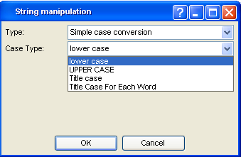
String Manipulation
Simple case conversion
  lower case
  UPPER CASE
  Title Case – First letter of first word in variable is upper case
  Title Case Each Word
Notes:
Simple case conversion
UPPER CASE
lower case
Title Case – First letter of first word in variable is upper case
Title Case Each Word
No options for conditional casing

Slide 21
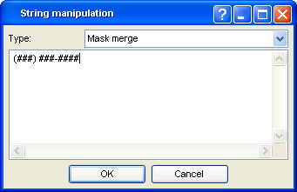
String Manipulation
Mask Merge – Used for easy text fields formatting
Example:
  Input string is 1234567890
  Want to print as (123) 456-7890
  Inside of Mask Merge enter (###) ###-####

Slide 22
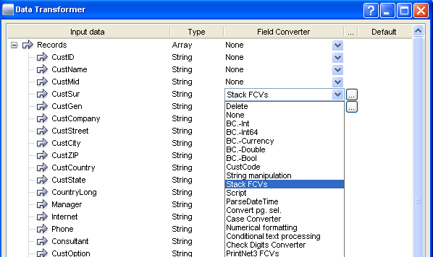
Stack FCVs – Selecting Converter
Stack FCVs – Combines several converters into one multi-converter.
Conversion sequence is committed step-by-step (converter after converter).
Notes:
Click “…” button to open and edit Stack FCVs.

Slide 23
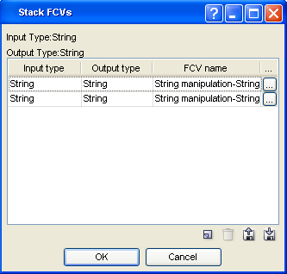
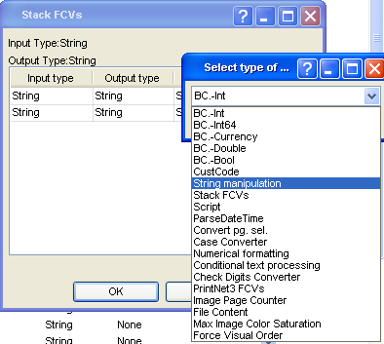
Stack FCVs
Stack as many Field Converters to one field as you want.
Choose type for each stacked converter.

Slide 24
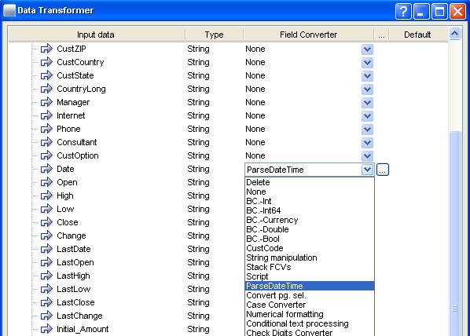
ParseDateTime – Selecting Converter
Select ParseDateTime converter from combo-box in Data Transformer.
Notes:
Click “…” button to open and edit ParseDateTime.

Slide 25
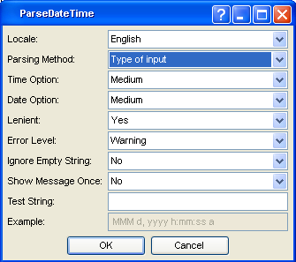
ParseDateTime
ParseDateTime – Converts text
to the format of date and time.
Choose from basic formats
or “user” formats.
After conversion the user is
able to add, subtract, or
reformat the date with other
converters.

Slide 26
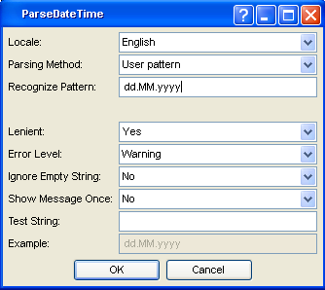
ParseDateTime
Set your own user pattern for recognizing the Input String in a Date field

Slide 27
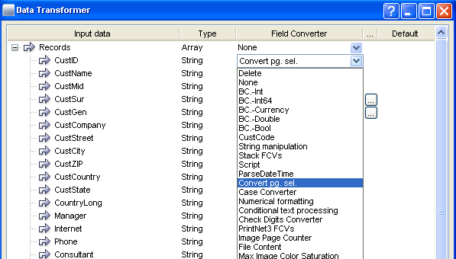
Convert Page Selection – Selecting Converter
Select Convert pg. sel. converter from combo-box in Data Transformer.

Slide 28
Convert Page Selection
Convert Page Selection – Converts PrintNet 3 format of page selection to PrintNet T:
  PrintNet 3 format – “0104” would be the way to tell the software to print Layout Page 1 and Layout Page 4
  PrintNet T format – “0,3”

Slide 29
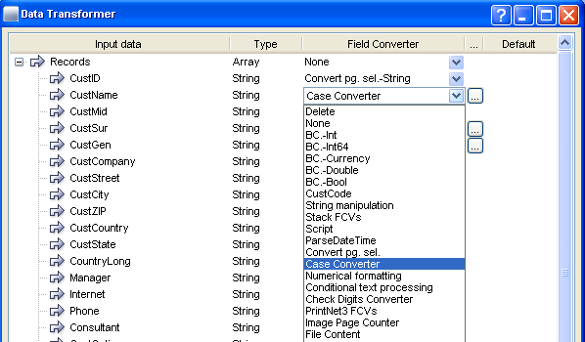
Case Converter – Selecting Converter
Select Case Converter from combo-box in Data Transformer.
Notes:
Click “…” button to open and edit Case Converter.

Slide 30
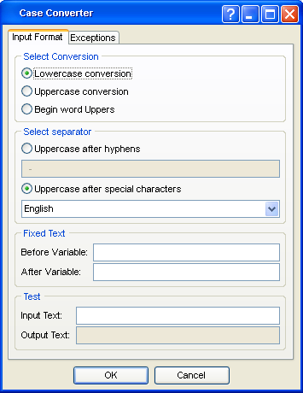
Data Transformer – Case Converter
Case Converter – Standard
case converter
Exceptions tab allows you to
load a text file to list special
conversion cases
  Example: O’BRIEN would normally convert as O’brien
  Exception example – “0’” tells it to make the “B” uppercase (“O’Brien”).

Slide 31
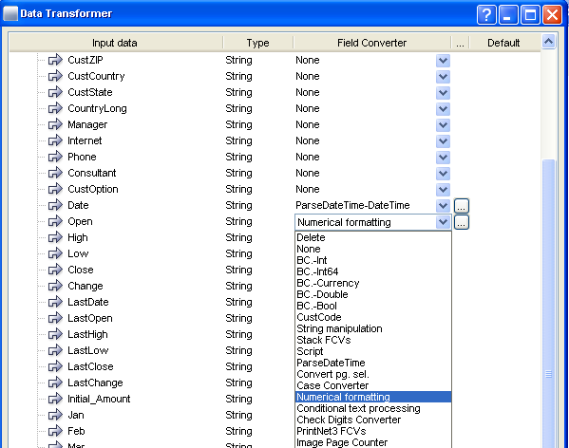
Numerical Formatting – Selecting Converter
Select Numerical Formatting from combo-box in Data Transformer.
Notes:
Click “…” button to open and edit Numerical Formatting.

Slide 32
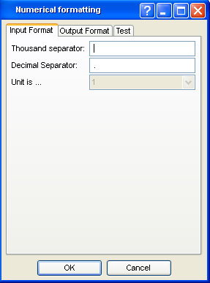
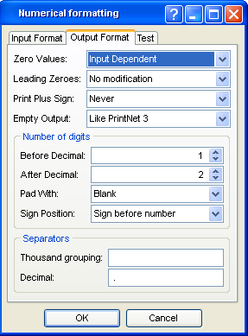
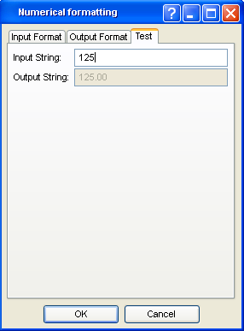
Numerical Formatting
Numerical Formatting – Format the output and appearance of your numerical variables.

Slide 33
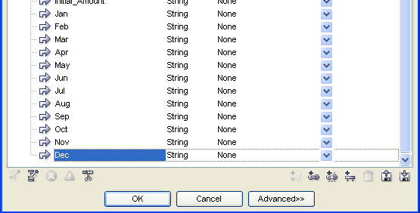
Linked Fields
Linked Fields – Creates new linked variable.
Value from “Linked” variable is copied into the new variable
before conversions are applied.

Slide 34
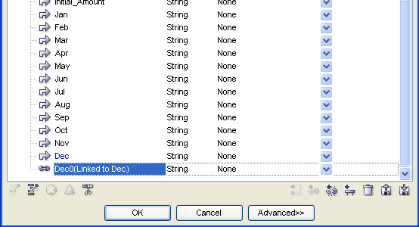
Linked Fields – Example

Slide 35
Unlinked Fields
Unlinked Fields – Creates new unlinked variable.
Variable has no value until a converter is applied.

Slide 36

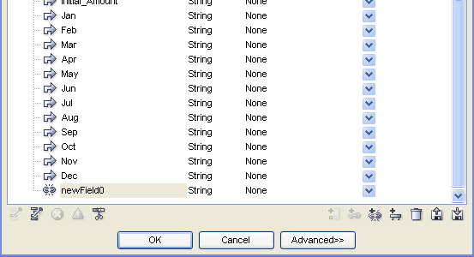
Unlinked Fields – Example
You have to define the data type in an unlinked field

Slide 37
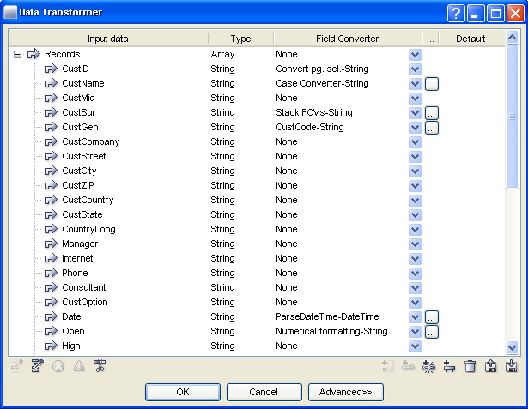

Data Transformer – Saving Settings
You can save all of the settings of a converter to an external file.
Creates a library of standard functions.
Save a commonly-used collection of data field transformations for later jobs
Notes:
You can save all of the settings of a converter to an external file.
Creates a library of standard functions that can be used in later jobs which use the same data input and require the same transformations.

Slide 38
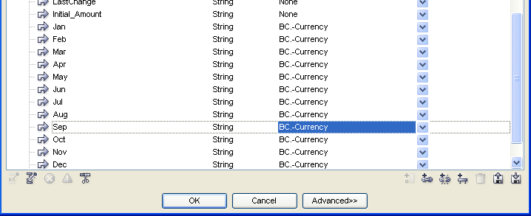
Data Transformer – Copy and Paste
You can copy a conversion by pressing Ctrl+C.
Move to a new field.
Use Ctrl+V to paste the conversion onto the new field.
Notes:
You can also access the Copy and Paste functions by right-clicking.

Slide 39

Data Transformer – Exercise I
Using a Data Transformer, apply conversions in datatransformer.wfd.
Open datatransformer.wfd file
  Convert Description to uppercase
  Convert Date from user pattern dd.MM.yy (“ParseDateTime”)
  Convert Number1 to BC.-Double – ‘.’ decimal places separator
  Convert Number2 to BC.-Currency
  Convert BoolVar to BC.-Bool
Use Data Proof <F6> to verify your changes.
Notes:
Solution can be found in datatransformerDone.wfd

Slide 40

Data Transformer – Summary
In this presentation we have learned:
  The purpose and function of the Data Transformer module
  About different converters
  How to:
    Delete data fields from a data input selection
    Stack field converters (Stack FCVs)‏
    Create linked and unlinked data fields

Slide 41

Data Transformer – Discussion
When are Data Transformers necessary?
What happens after you delete a field in Data Transformer?
Why would you use Stack FCVs?
What are the common data types?
Notes:
1. When are Data Transformers necessary?
Because all data enters a workflow as string; if you want to perform calculations on numerical data, you need to convert the string to a calculable data type (Double, Currency). If you want to parse the time and date you’ll need a Data Transformer to change the string data in a Date/Time type.
What happens after you delete a field in Data Transformer?
The data field is no longer available for use in your workflow; however, the field is NOT deleted from the original data file.
3. Why would you use Stack FCVs?
To perform multiple conversions on the same data field.
4. What are the common data types?
String, Double, Int, Int64, Currency, Bool, Date/Time.

Slide 42

Thank You.
Do You Have Any Questions?

